Slide 1
Process Framework
Process
Multi Task Process
Thread
Task 0
Resource Provider
Task 1
Task n
Program Structure

Slide 2
Concept of the Gateway
Upstream
Clients
Gateway
Broker
Downstream
Upstream (Client) | Downstream (Gateway)
SERCHGW | GWINFO
REGISTER | REGACK
REGACK | REGISTER
Upstream (Client) | Downstream (Broker)
SUBSCRIBE | SUBACK
PUBLISH | PUBACK
PUBACK | PUBLISH

Slide 3
Task Relations
Gateway
Main
Task
Resource Provider
Broker
Send
Queue
Gateway
Event
Queue
Client
Send
Queue
Broker
Send
Task
Broker
Receive
Task
Client
Receive
Task
Client
Send
Task
Broker
Clients

Slide 4
Event Queue Structure
Message Queue upstream
< MQTT Message >
Event Queue
<Template>
Message Queue downstream
< MQTT Message >
Client Node
Message Queue upstream
< MQTT-Sn Message >
Event
MQTT-Sn
Message
Message Queue downstream
< MQTT-Sn Message >
Type of Events
- Broker Send
- Broker Recv
- Client Send
- Client Recv
- Broadcast
- Timeout
Broadcast
- SERCHGW
- GWINFO
- PUBLISH
MQTT Message
Connect

Slide 5
Resource Class
clients
Gateway
Event
Queue
Client
Node
Broker
Send
Queue
Topics
Message
Queue< >
Client
Send
Queue
Topic
Resource Class
Helper Class

Slide 6
Process Framework Class
Process
Multi Task Process
Thread
Mutex
Semaphor
Timer
Exception
EventQue< >

Slide 7
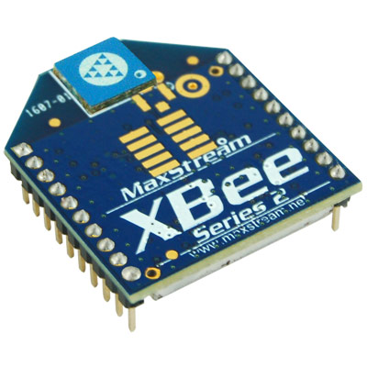
XBee S2 Comunication Data Flow
ClientRecvTask
_zb.getResponse (resp);
From:Client
To:Client
ClientSendTask
_zb.unicast (address64, address16,
payload, payloadLength,
option)
XBee
receiveResponse (resp){
readPacket();
}
resp->absorb (&_response)
Receive
Send
XBee
sendRequest (_txRequest){
sendByte();
}
XBeeResponse _response
ZBeeStack _zb
unicast (request) {
address64, address16,
payload, payloadLength,
option){
_txRequest.setAddress16();
_txRequest.setAddress64();
sendRequest(_txRequest);
}
ZBeeStack _zb
getResponse (resp) {
XBee::receiveResponce (resp);
}
ClientNode
XBeeAddress64 _address64;
Uint16_t _address16;
UTFString _clientId;
MQTTSnMessage* recvMessage;
MQTTSnMessage* sendMessage;
XBeeRequest _txRequest;
XBeeResponse* resp;
Event
ClientNode* _clientNode;
MQTTSnConnect* conect;
connect->absorb (resp);
MQTTSNMessage* msg;
Gateway
Event
Queue
Client
Send
Queue
GatewayControlTask
Event* ev = Que->wait(); or Que->post(ev);

